Slide 2
Communication
Planning
Resources
Operational
Efficiency
Efficient Meetings
Does it need to be a meeting or Teams Chat
Does everyone need to be there
Do they need to be in whole meeting
Needs to have an agenda with action items
Scheduling (average 8 min to schedule meeting)
Scenario
Miss 1 meeting a week
$234,000 per year
Notes:
This was calculated based on current staff, average pay rates, etc.

Slide 3
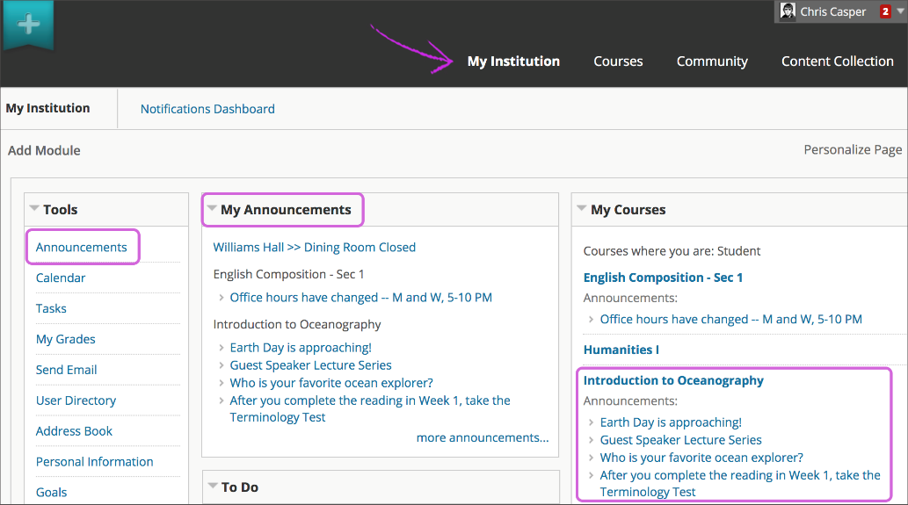
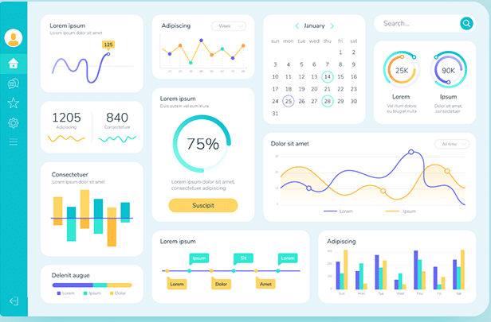
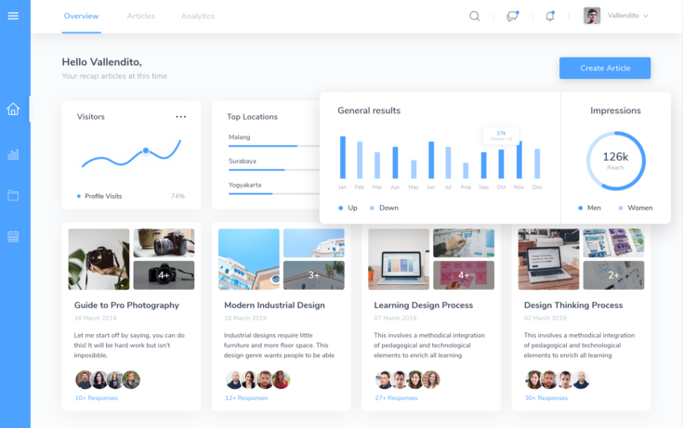
Scenario 1
Send IT Tip email to 300 people
($30/hr, 30 seconds to find email)
300 x .5 x 260 = $39,000 per year
5 email per day = $195,000 per year
Scenario 2
Email and Collaboration Alerts
300 x .25 x 260
30 alerts per day = $585,000 per year
Notes:
This was calculated based on current staff, average pay rates, etc.
(300 employees, 30 seconds to find email, 260 work days per year)
(300 employees, 15 seconds to check alert, 260 work days per year)
The numbers are averages and used for reference

